Slide 1
Internship Learning Presentation on Enterprise Automation Framework using Playwright
Ayush Srivastava
(Custom Software Engineering Associate)

Slide 2
Project Statement
Problem Statement​
The Technology Support request process involved multiple manual interactions through Accenture Support Portal. Repetitive navigation, form filling and browser specific behavior made the process time consuming and difficult to validate consistently.
Scope of Automation
Navigate through the Accenture Support Portal.
Handle enterprise authentication and browser session management.
Automate the Technology Support ticket creation workflow.
Support execution across Microsoft Edge, Google Chrome, and Mozilla Firefox.
Improve framework maintainability and execution reliability.​

Slide 3
Framework Evolution
1
2
3
4
Basic Script
Reusable Framework
Cross-Browser Support
Stable Enterprise Automation
Phase 1 – Initial Automation
Started with Basic Playwright script for Microsoft Edge
Automated the ticket creation workflow
Static waits and hardcoded test inputs (Using Codegen)
Phase 2 – Framework Enhancement
Refactored for code organization and reusability
Browser-specific profile management for authentication
Added cross-browser execution support: Edge, Chrome, Firefox
Phase 3 – Stability & Scalability
Replaced static waits with dynamic element synchronization
Improved popup handling and browser-specific execution flow
Optimized the framework for reliable and maintainable automation

Slide 4
Framework Architecture
Framework Components
Execution Flow
Key Design Principles
Playwright Test Runner for test execution and browser orchestration.
Browser-specific profiles to maintain enterprise authentication sessions.
Configuration layer for browser management and execution settings.
Automation scripts implementing the Technology Support workflow.
Reusable utility methods for common browser interactions and synchronization.
Test Execution
Modular and maintainable project structure.
Reusable automation components.
Browser-independent execution.
Separation of test logic and test data.
Improved stability through dynamic synchronization.
Playwright Configuration
Browser Selection
Persistent Browser Profile
Enterprise Authentication
Technology Support Workflow
Ticket Creation Process

Slide 5





Key Features Implemented
Cross-Browser Automation
Edge • Chrome • Firefox
Enterprise Authentication
Persistent Browser Profiles
Reusable Test Framework
Modular Structure
Reliable Test Execution
Dynamic Synchronization
Scalable Design
Easy Future Enhancements

Slide 6
Challenges Faced & Solutions
⚠ CHALLENGE
✔ SOLUTION
Enterprise SSO and Passkey authentication caused inconsistent browser sessions.
Implemented persistent browser profiles to maintain authenticated sessions across executions.
Different browsers exhibited different behavior during automation execution.
Introduced browser-specific configurations to ensure consistent execution across supported browsers.
Popup windows and browser navigation caused synchronization issues.
Implemented event-based popup handling and improved browser synchronization.
Static waits affected execution time and reduced test reliability.
Replaced static delays with dynamic waits based on element and page state.
Initial automation was difficult to maintain due to hardcoded values.
Refactored the framework into a modular and configurable structure with externalized test data.

Slide 7
Project Outcomes
INITIAL FRAMEWORK
FINAL FRAMEWORK
Single browser execution
✓ Cross-browser framework
Hardcoded test inputs
✓ Configurable test data
Static waits
✓ Dynamic synchronization
Temporary session
✓ Persistent authentication
Basic automation script
✓ Modular & reusable framework
BUSINESS VALUE
Reduced repetitive manual effort
Improved execution consistency
Easier maintenance & enhancements
Reusable automation foundation

Slide 8
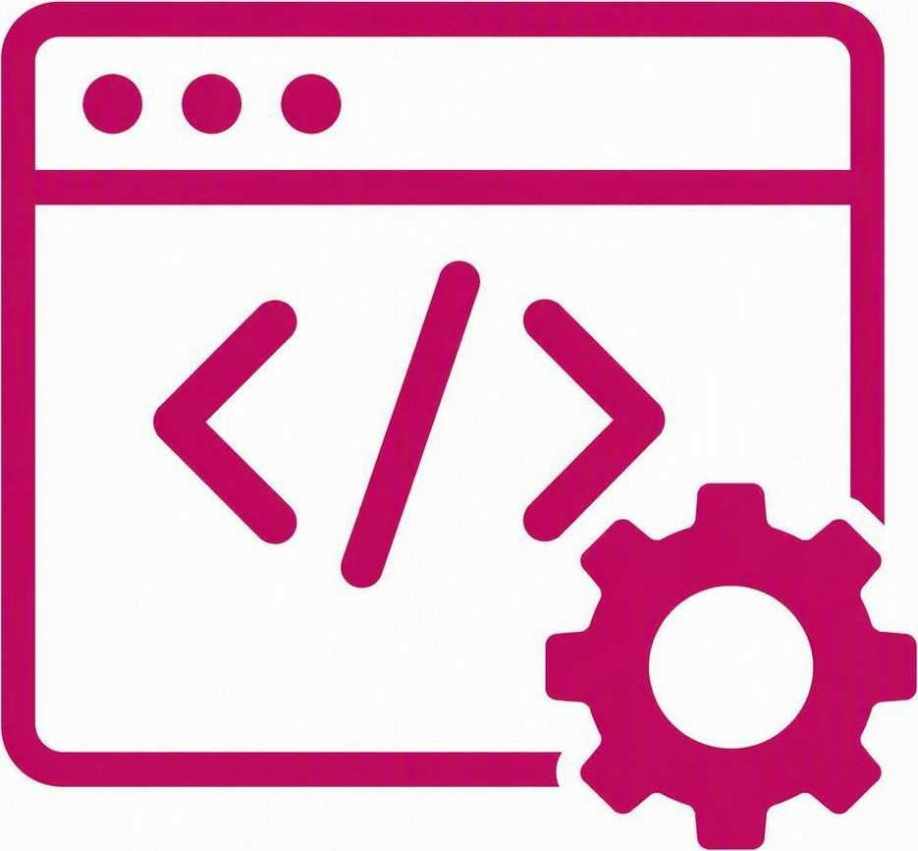

Key Learnings
Technical Learnings
Developed a strong understanding of browser automation using Playwright and TypeScript.
Learned to design scalable, modular, and reusable automation frameworks instead of standalone scripts.
Gained practical experience in handling enterprise authentication, browser-specific execution, and synchronization challenges.
Improved debugging skills by analyzing browser behavior, automation failures, and execution logs.
Understood the importance of writing stable automation through dynamic waits, modular design, and reusable components.
Professional Learnings
Understood how enterprise automation projects are developed through iterative improvements rather than a one-time implementation.
Strengthened analytical and problem-solving skills by independently researching, experimenting, and resolving technical challenges.
Experienced working in an Agile environment with regular progress updates, reviews, and continuous improvements.
Learned the importance of writing maintainable, scalable, and production-oriented automation solutions.

Slide 9
Thank You
Ayush Srivastava
Custom Software Engineering Associate

